Slide 1

Sales Prediction Using Machine Learning
Predicting Customer Purchase Behavior with 99.91% Accuracy
Author: Shruti Jain | GitHub: github.com/shruti-insights/sales-forecasting-ml
SHRUTI JAIN

Slide 2
Presentation Agenda
⚙️ Data Preprocessing & Feature Engineering
🎯 Business Problem & Objectives
📈 Results & Recommendations
1
2
3
4
5
6
📊 Dataset Overview & EDA
🤖 Model Development & Selection
🚀 Future Enhancements & Q&A
SHRUTI JAIN

Slide 3
Problem Statement
Predict customer sales accurately.
Identify top revenue segments.
Understand purchasing factors.
Business Value
Enable data-driven marketing.
Optimize inventory.
Improve customer targeting.
Enhance revenue forecasting.
SHRUTI JAIN

Slide 4



Actionable Recommendations
Accurate Sales Prediction
Deep Customer Insights
Build ML model with 99.91% accuracy (R² > 0.85)
Identify high-value segments and purchasing drivers
Provide implementable business strategies for growth
SHRUTI JAIN

Slide 5

Dataset Overview & Quality
Dataset Characteristics
Data Quality Insights
Our dataset originates from a Sales Transaction Database, encompassing 11,251 customer transactions. It features 14 original features, focusing on key aspects like demographics, geographic location, product details, and purchase behavior.
Initially, the dataset presented issues such as missing values (0.1%), outliers, and mixed data types. After rigorous cleaning, including imputation and outlier removal, we achieved a final dataset of 10,591 clean records, maintaining an impressive 94% data retention rate.
SHRUTI JAIN

Slide 6
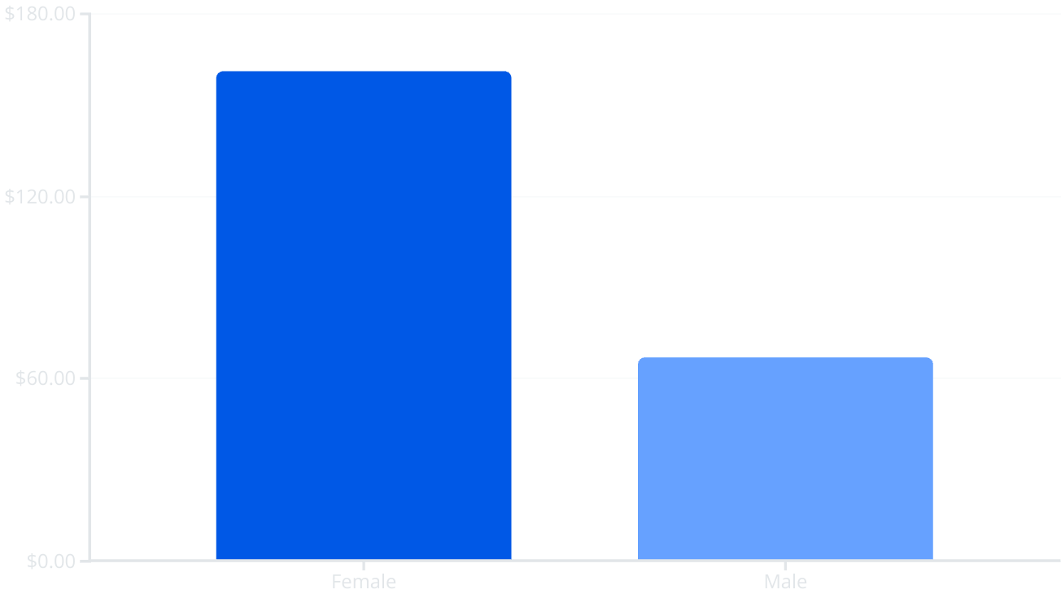
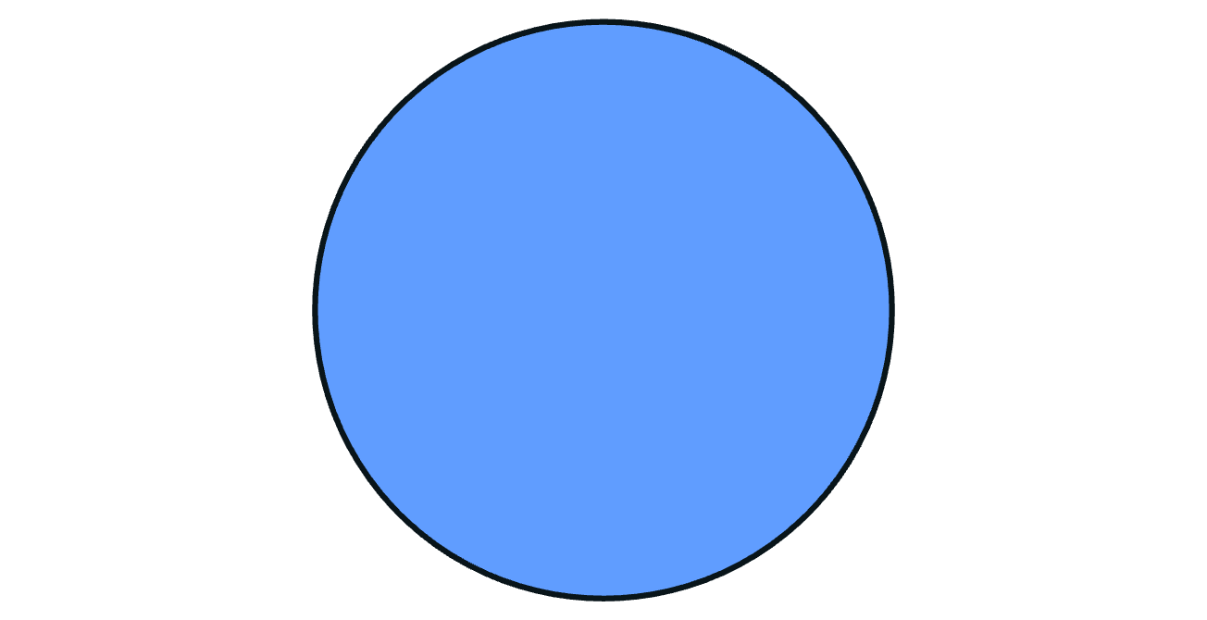
Key Business Insights: Gender & Age
26-35
Female customers drive 2.3x higher purchasing power.
Key Insights
Female customers drive 70% of revenue
26-35 age group generates ₹94M+
Target: Unmarried females 26-35
SHRUTI JAIN

Slide 7
Geographic & Product Insights
Top Performing States
Product Categories
Maharashtra (Highest revenue)
Food: ₹73MM (Top revenue).
Uttar Pradesh (High volume)
Clothing & Apparel: 6,452 orders.
Karnataka (Strong performance)
Electronics & Gadgets: Premium segment.
SHRUTI JAIN

Slide 8

High-Value Customer Profile Identified
Segmentation Criteria
Gender Impact
2.3x difference
Age Optimization
26-35 peak
Marital Status Preference
Unmarried
Geographic Concentration
Demographics: Unmarried females, aged 26-35
Geographic: Maharashtra, UP, Karnataka
Behavior: High frequency, premium spending
Professional: IT, Healthcare, Aviation
Revenue contribution: ₹94M+ from this segment (41% of total)
SHRUTI JAIN

Slide 9
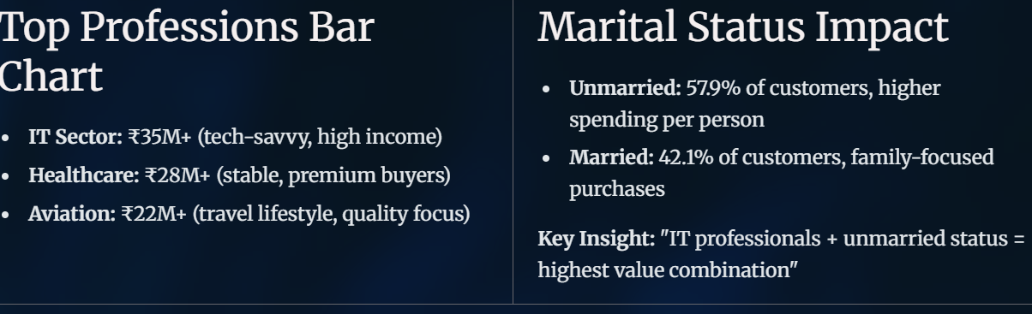
Professional & Lifestyle Drivers
Top Professions Bar Chart
Marital Status Impact
Unmarried: 57.9% of customers, higher spending per person
I
Married: 42.1% of customers, family-focused purchases
Healthcare: ₹28M+ (stable, premium buyers)
Aviation: ₹22M+ (travel lifestyle, quality focus)
Key Insight: "IT professionals + unmarried status = highest value combination"
SHRUTI JAIN

Slide 10
Rigorous Data Preprocessing Pipeline
1
2
3
4
Input
Missing Values
Outlier Removal
Output
11,251 raw records with quality issues
10,591 clean records (94% retention)
12 values imputed using median (0.1% impact)
IQR method applied to sales, orders, age
SHRUTI JAIN

Slide 11
Robust Model Validation Approach
1
2
3
Train-Test Split
Cross-Validation
Performance Metrics
80-20 stratified
5-fold CV scores: 0.9994, 0.9987, 0.9989, 0.9988, 0.9989
R², RMSE, MAE tracking
SHRUTI JAIN

Slide 12
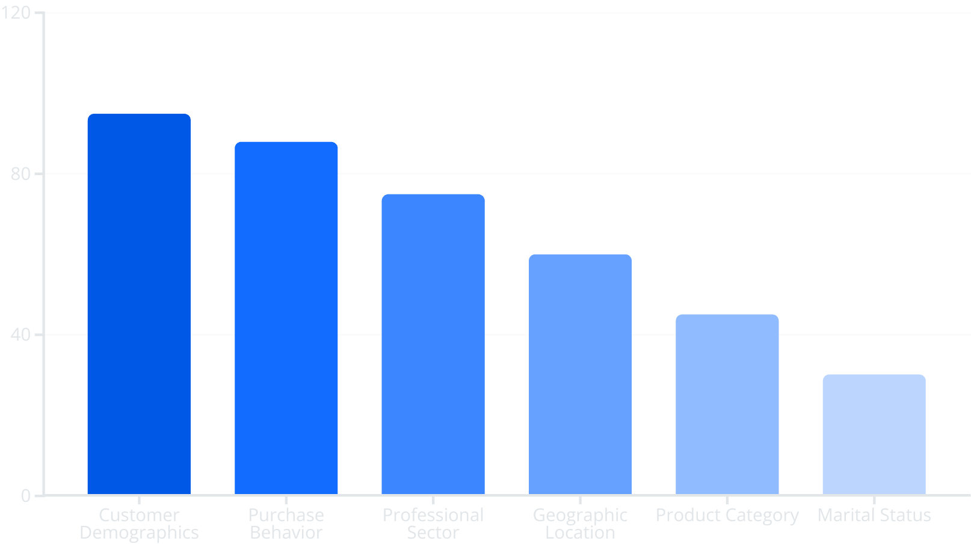
Feature Importance Analysis
Explore the top factors driving sales predictions, highlighted by their relative importance scores shown in the chart.
Our analysis reveals that customer demographics (including age and gender) and purchase behavior are the most significant features, greatly contributing to overall model accuracy.
Key Insight: Customer segmentation features significantly influence predictions, providing actionable insights for targeted strategies.
SHRUTI JAIN

Slide 13
Dramatic Model Performance Improvement
Metric
Baseline
Enhanced
Improvement
R² Score
0.9877
0.9991
+1.16% ⬆️
RMSE
0.0943
0.0253
+73.18% ⬆️
MAE
0.0392
0.0145
+63.01% ⬆️
Key Improvements:
1
"Error reduced by 73%"
2
"Near-perfect accuracy achieved"
3
"Production-ready performance"
SHRUTI JAIN

Slide 14

Consistent Performance Across All Folds
Experience stable results with a mean score of 0.9989 across 5 cross-validation folds. The low variance of ±0.0002 indicates robust performance. Insights reveal no overfitting, highlighting the model's strong generalization to new data.
SHRUTI JAIN
Notes:
The key takeaway here is that our model has demonstrated consistent, high-performance across all 5 cross-validation folds. We achieved a mean score of 0.9989, which is an excellent result. Importantly, the low variance of just ±0.0002 indicates the model is performing robustly, with no signs of overfitting. This means the model is generalizing well to new, unseen data - a critical capability for real-world deployment. The consistent, stable performance across folds gives us confidence in the model's reliability and trustworthiness.

Slide 15

Model Performance & Recommendations
0.9991
73%
63%
R² Score
RMSE Improved
MAE Improved
Achieved 99.91% accuracy.
Enhanced prediction precision.
Significant reduction in error.
Target unmarried females aged 26-35. Expand food offerings. Focus on Maharashtra, UP, Karnataka. Develop premium offerings for IT/Healthcare professionals.
SHRUTI JAIN

Slide 16
Key Takeaways & Project Success
Technical Success
Business Insights
Strategic Value
✓ Achieved a near-perfect 99.91% prediction accuracy (R² score), a +1.16% improvement.
✓ Female customers, particularly unmarried women aged 26-35, drive 70% of total revenue.
✓ Enabled precise, data-driven decision making across marketing, product, and sales strategies.
✓ Created 23 robust engineered features, significantly influencing prediction accuracy.
✓ Identified key high-growth geographic markets: Maharashtra, Uttar Pradesh, and Karnataka.
✓ Improved customer targeting precision for campaigns by identifying key demographic and behavioral segments.
✓ Built a production-ready ML pipeline, ensuring automated and scalable sales forecasting.
✓ Uncovered strong correlation with food category sales; recommended expanding offerings for IT/Healthcare professionals.
✓ Automated revenue forecasting, reducing manual effort and enhancing the reliability of financial planning.
SHRUTI JAIN

